Slide 1


FORENSICS
1 - Foundations
!! nos4a2
@sluzypt
AFSC19.EXE @afsc19

Slide 2
ROAD
MAP
1. Foundations
2. Disks, registries
3. Memory
4. ???

Slide 3
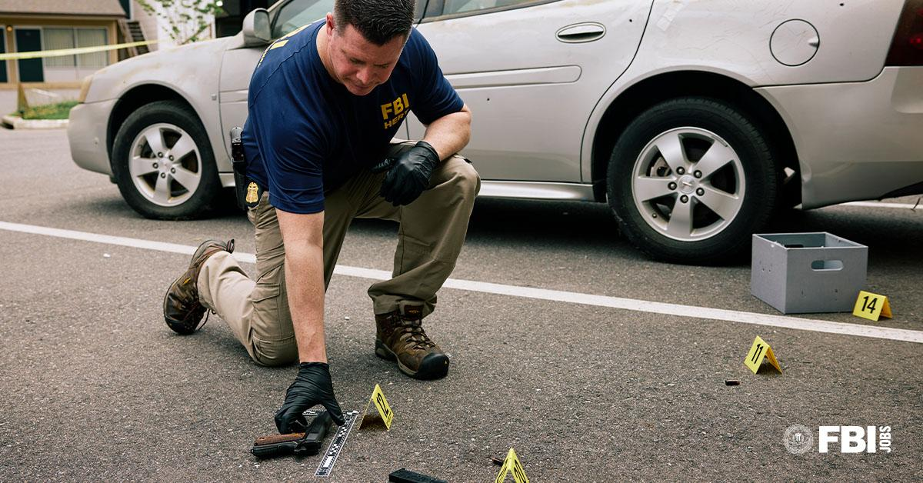
What is Forensics?

Slide 4
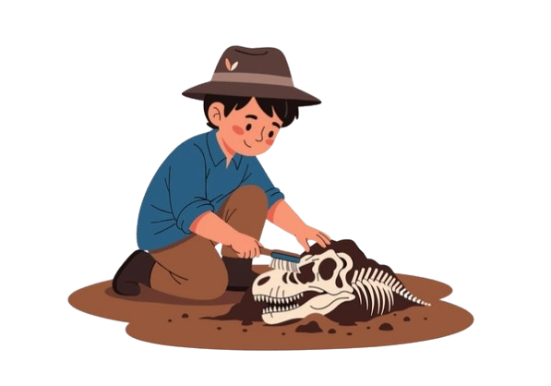

Static & Dynamic Analysis
VS
Static
Dynamic

Slide 5
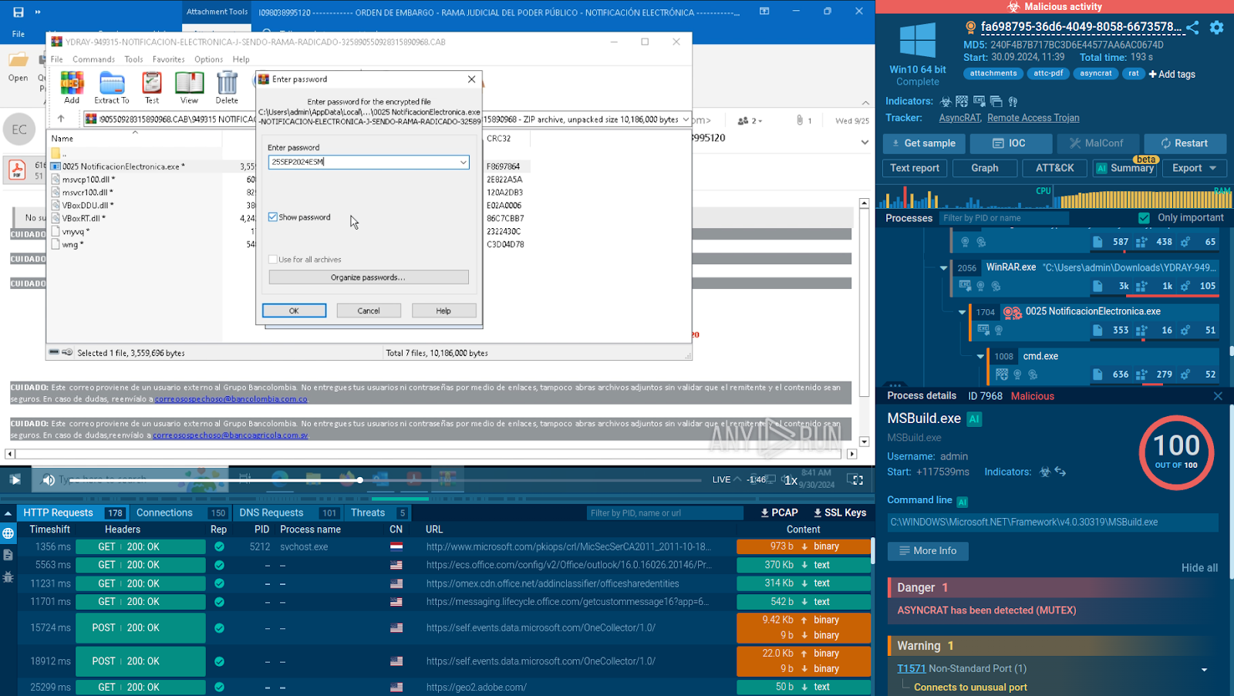
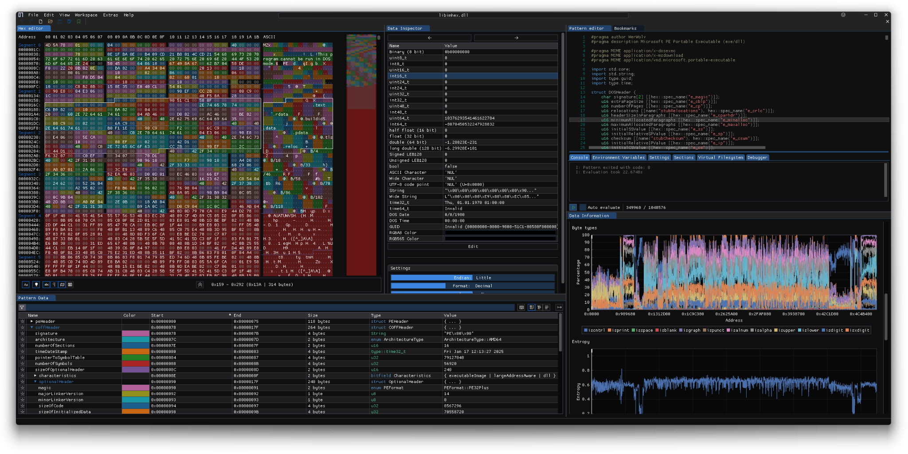
Static & Dynamic Analysis
VS
Static
Dynamic

Slide 6
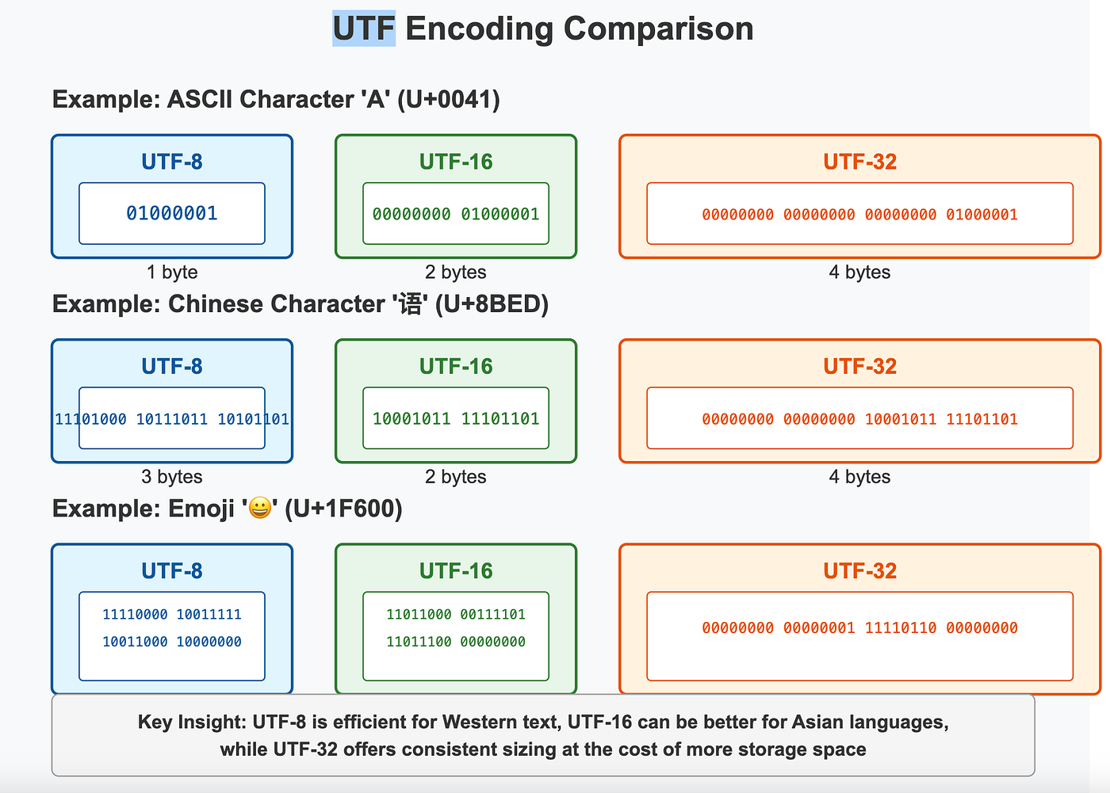
Data encoding schemes

Slide 7
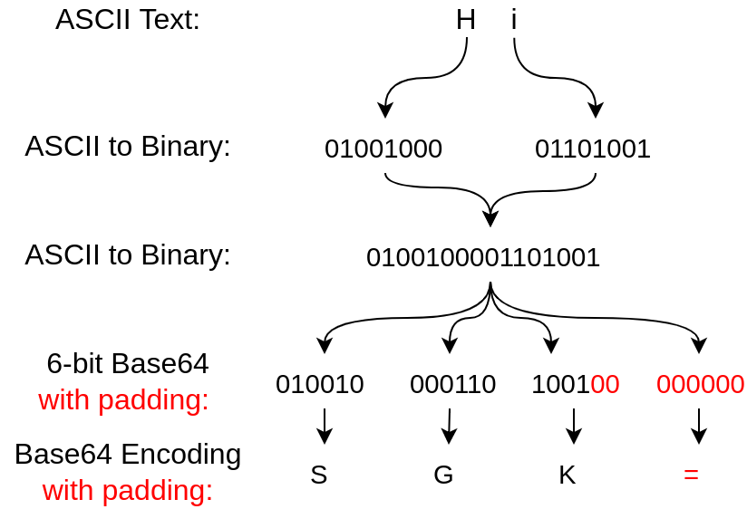
Data encoding schemes

Slide 8
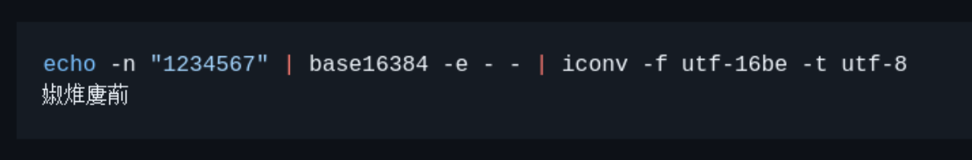
Data encoding schemes
Infinite encodings!

Slide 9

BUT WHAT
ENCODING IS
THIS?
CyberChef it!
PS: Check entrophy!
High Entrophy = Compressed data

Slide 10
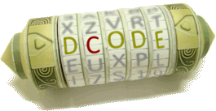
CYBERCHEF
ISN’T ALL!
, …

Slide 11
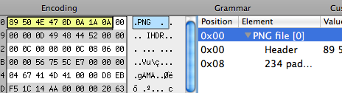
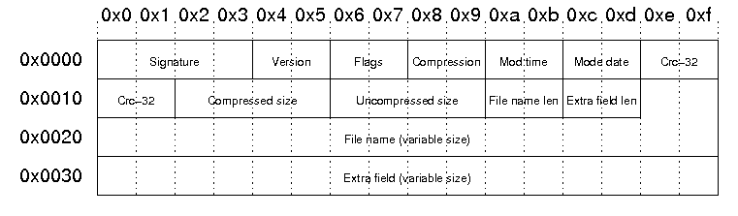
What are files?
Just data… with a header
And sometimes with a pretty structure

Slide 12
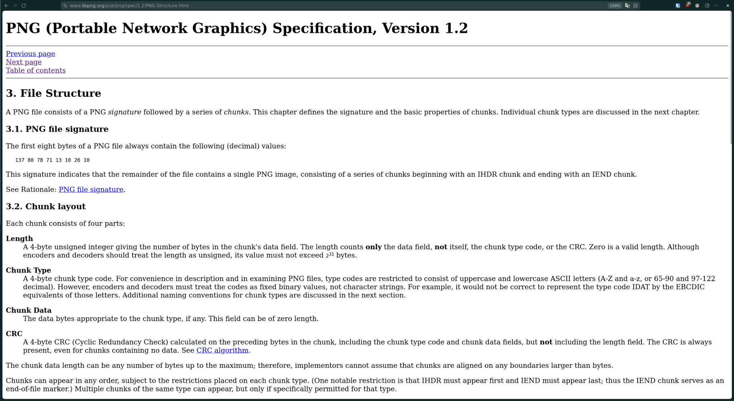
What are files?

Slide 13
What are files? - Tools
Type based on the header
Find headers inside other files
❯ file stt_logo.png
stt_logo.png: PNG image data, 1141 x 549, 8-bit/color RGBA, non-interlaced
❯ binwalk stt_logo_sus.png
DEC HEX DESCRIPTION
----------------------------------------------------------------
0 0x0 PNG image, total size: 11568 bytes
11568 0x2D30 PNG image, total size: 11567 bytes
Analyzed 1 file for 85 file signatures (187 magic patterns)
Structure metadata
Strings
❯ exiftool stt_logo_sus.png
ExifTool Version Number : 13.58
File Name : stt_logo_sus.png
Directory : .
File Size : 23 kB
File Modification Date/Time : 2014:10:18 01:01:01+00:00
(…)
Comment : How would one even read this??
❯ strings imgs.zip
stt_logo.pngUT
zWTTK
CV :d
u{[z
SrwJ
(...)

Slide 14
What are files? - Tools
File specific
❯ webpinfo stt.webp
RIFF HEADER:
File size: 20576
Chunk VP8X at offset 12, length 18
ICCP: 0
Alpha: 1
EXIF: 0
XMP: 0
Animation: 0
Canvas size 600 x 420
Chunk ALPH at offset 30, length 1262
(...)
No error detected.

Slide 15
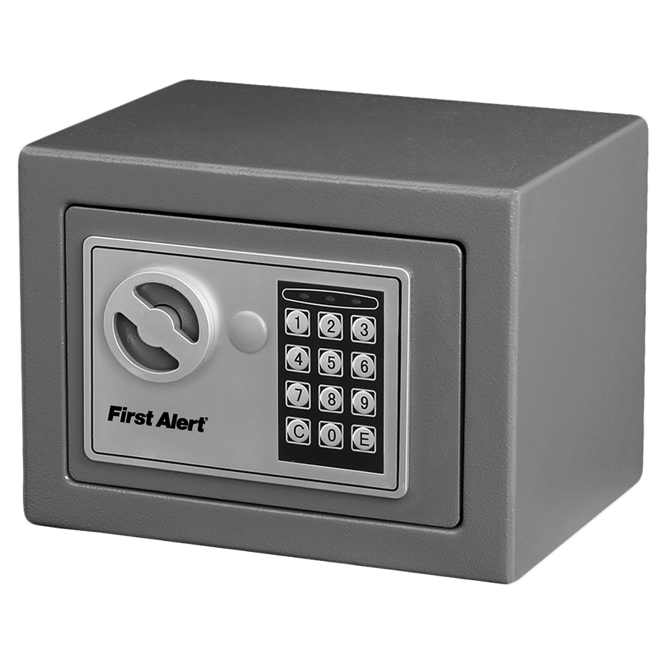

What’s Stego?
VS
Encryption
Steganography

Slide 16
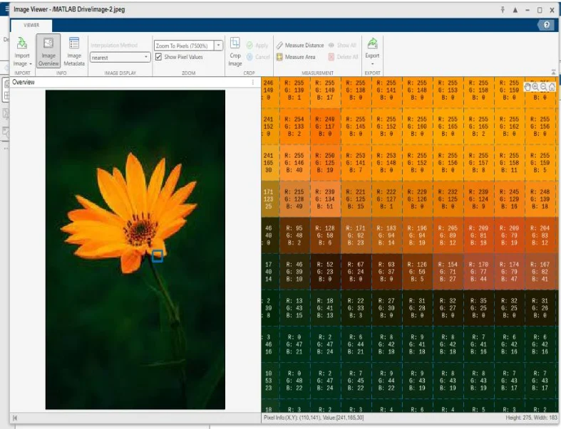
IMAGE STEGANOGRAPHY
What are images?
A matrix of pixels!
Pixels[width,height] = img.load()
And what are pixels?
Red, Green, Blue, Alpha (0-255)
Pixels[x,y] = r,g,b,a
Pixels[x,y] = r,g,b

Slide 17
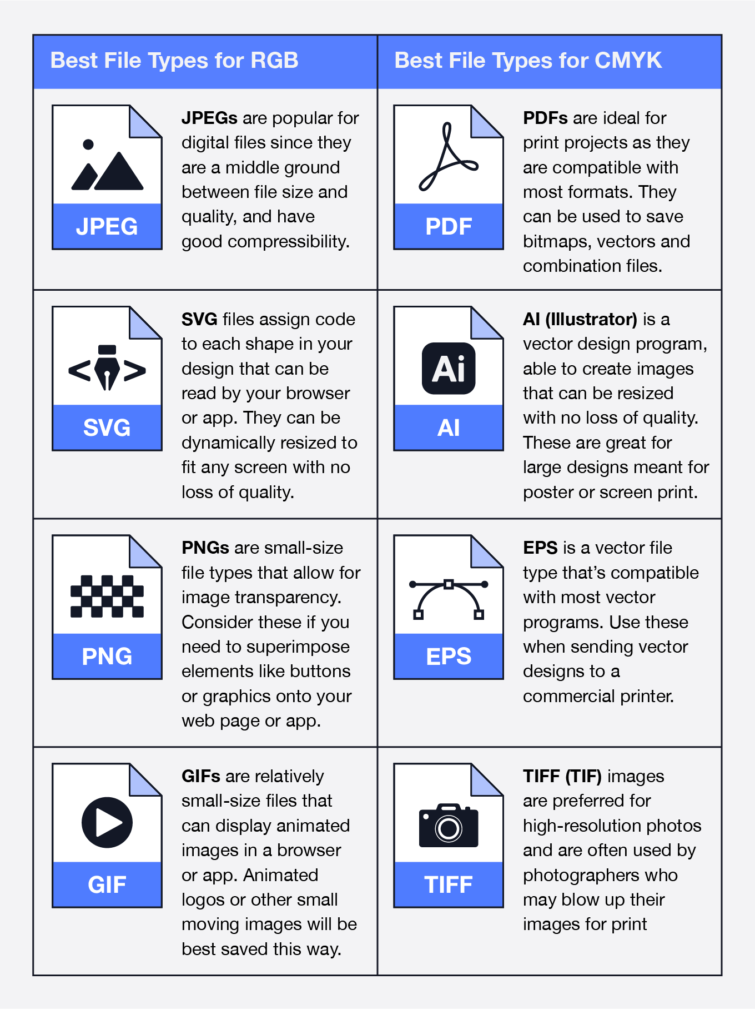
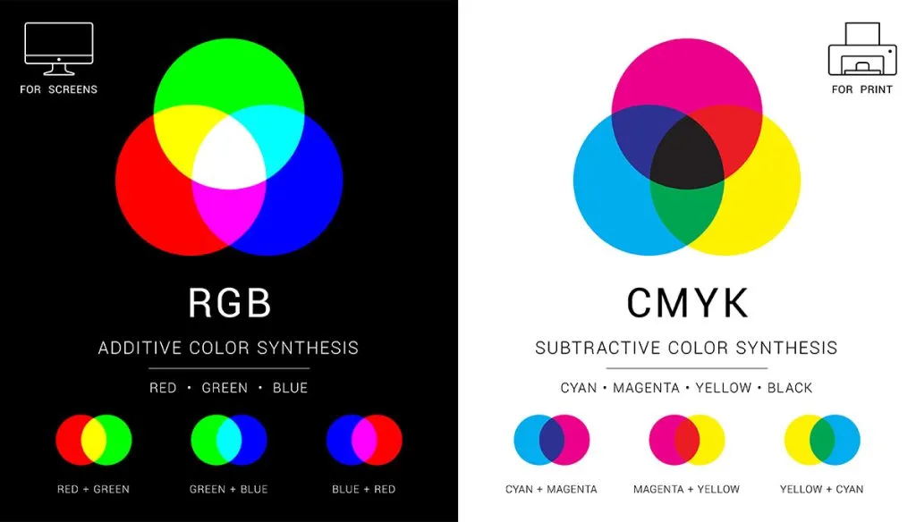
IMAGE STEGANOGRAPHY
RGB is just one color mode!

Slide 18






IMAGE STEGANOGRAPHY
MSB & LSB
Tools: zsteg, stegsolve
1 LSB
4 LSB
1 MSB
Pixel[x,y] = R, G, B
= 01011011, 00111100, 10110101
newPixel[x,y] = R, G, B = 01011010, 00111101, 10110101
Pixel[x,y] = R, G, B
= 01011011, 00111100, 10110101
newPixel[x,y] = R, G, B = 01010010, 00111011, 10111110
Pixel[x,y] = R, G, B
= 11101010, 01100101, 10111011
newPixel[x,y] = R, G, B = 01101010, 11100101, 10111011

Slide 19
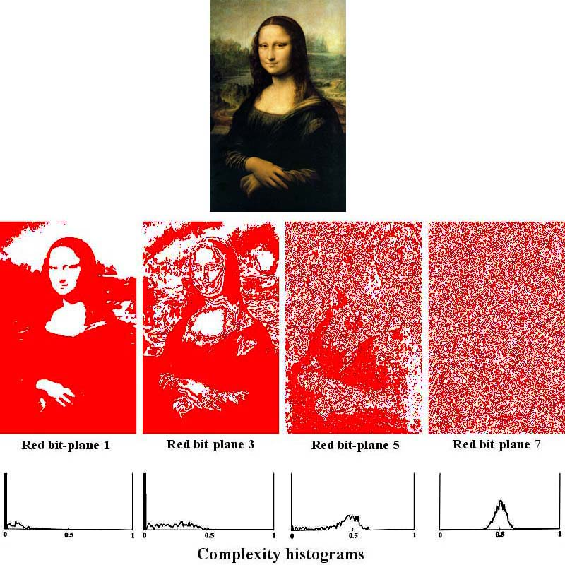
IMAGE STEGANOGRAPHY
Bit planes
R, G, B = Pixel[x,y] newPixel[x,y] = R[7]
(fill the pixel when Red’s 7th bit == 1)
use StegSolve!

Slide 20


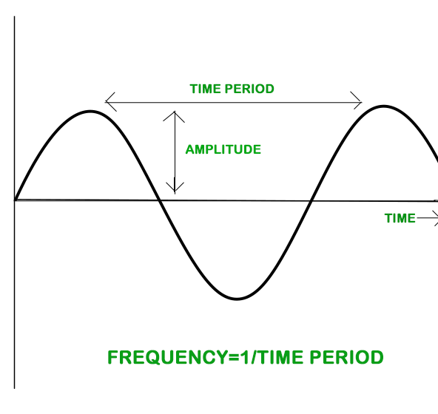
AUDIO STEGANOGRAPHY
What are audios?
A sequence of amplitude samples! samples[freq*time] = amplitude
Frequency = n_samples/second
A file with 44.1khz contains 44100 samples per second!
amp_after_2s = samples[44100*2]

Slide 21
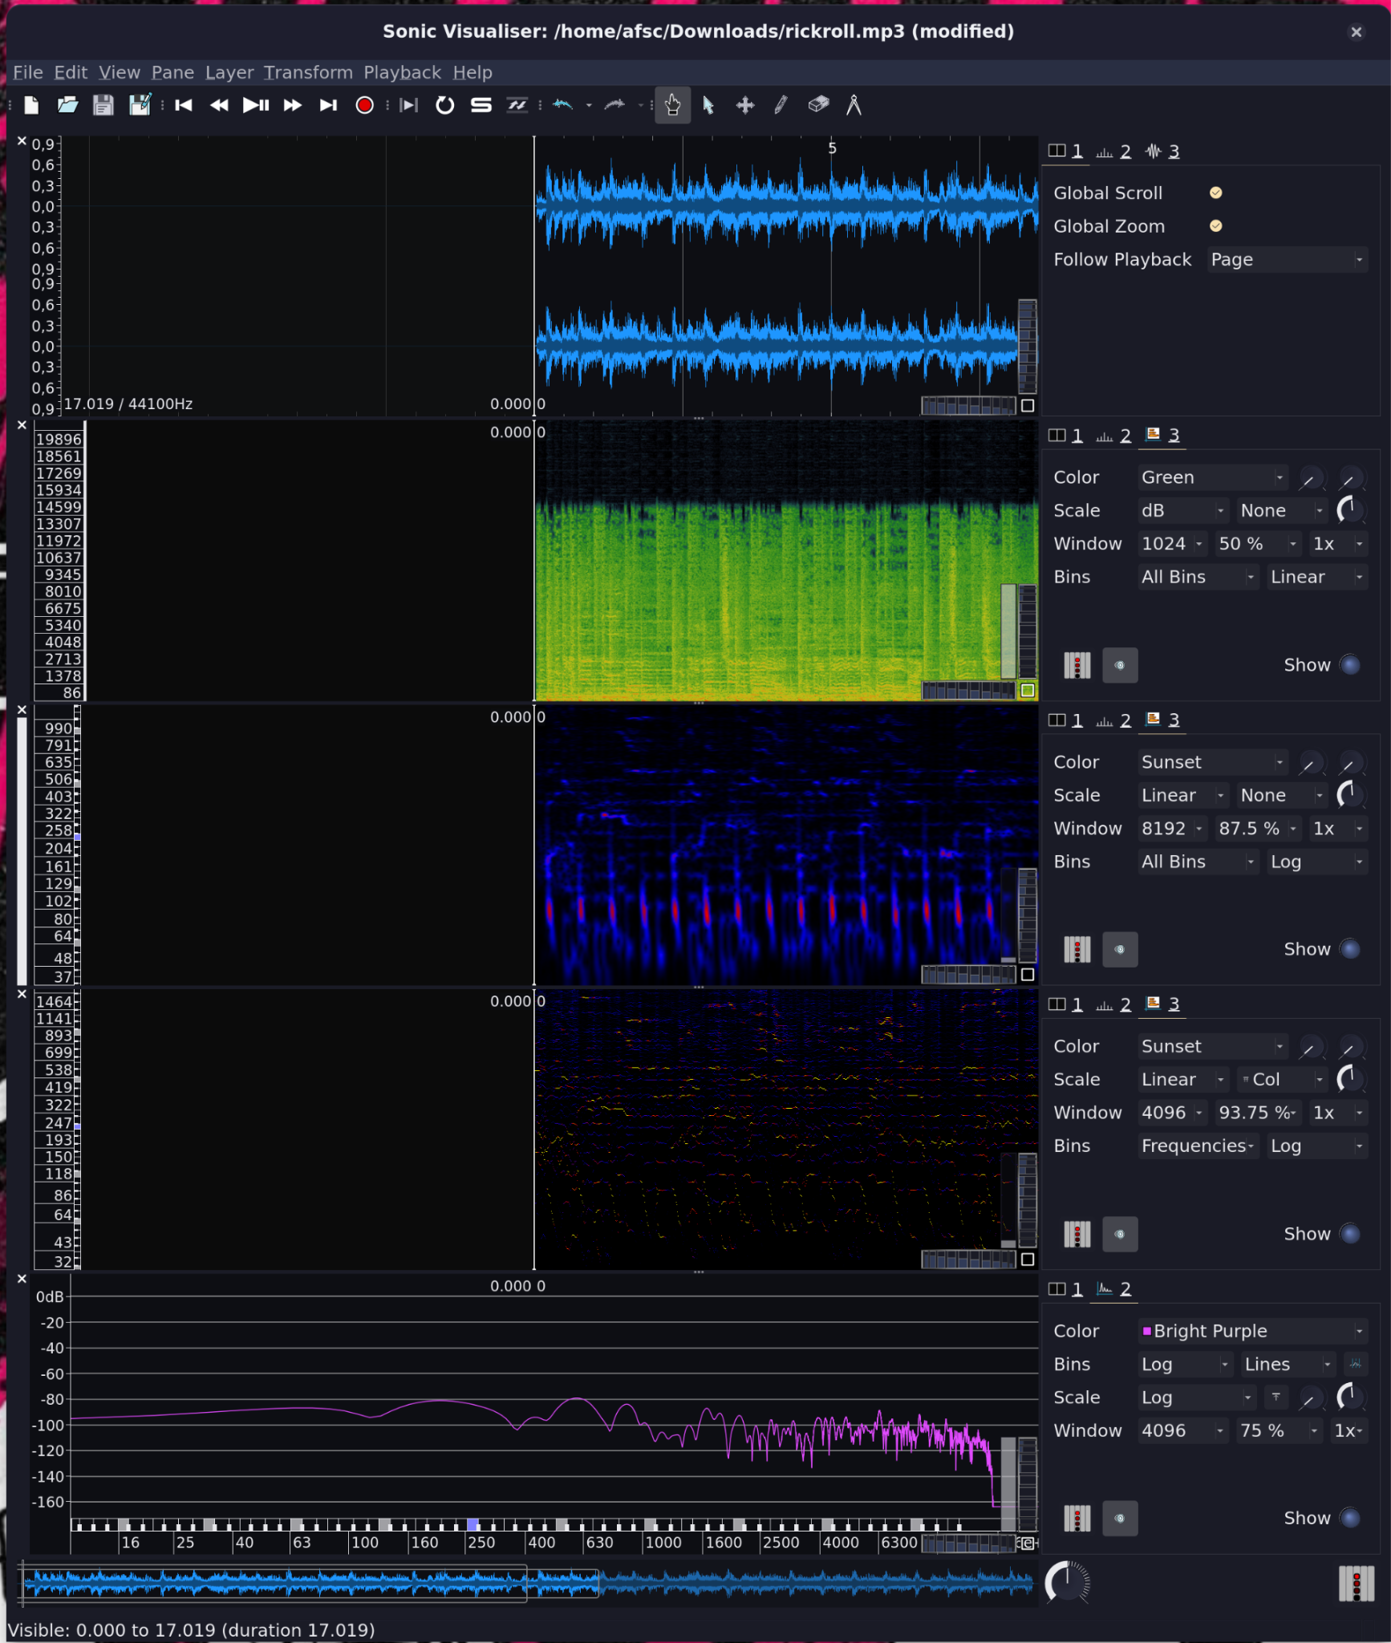
AUDIO STEGANOGRAPHY
Data sequences can be visualised!
x=index, y=value
And much more ways…
Visualise: Sonic Visualiser Edit: Audacity
A normal rickroll

Slide 22
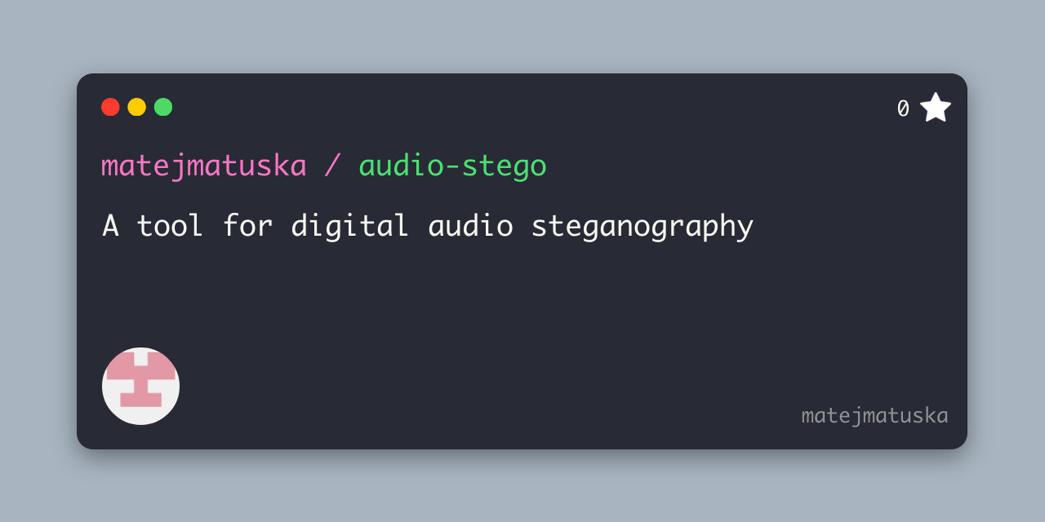

Steganography
Sometimes it’s all about a random tool….

